Slide 1
Introduction to Deep Learning
Dr. Bharathi R
CSE Department

Slide 2
Applied Machine Learning SEZG568/SSZG568
Session 13(4th Nov,2023)

Slide 3
Session 13 – 4th November,2023
13. | Artificial Neural Networks: Deep Learning, Characteristics, Error Surface, hyperparameters, Regularization, Weight Updates. | T1: Chapter 11

Slide 4
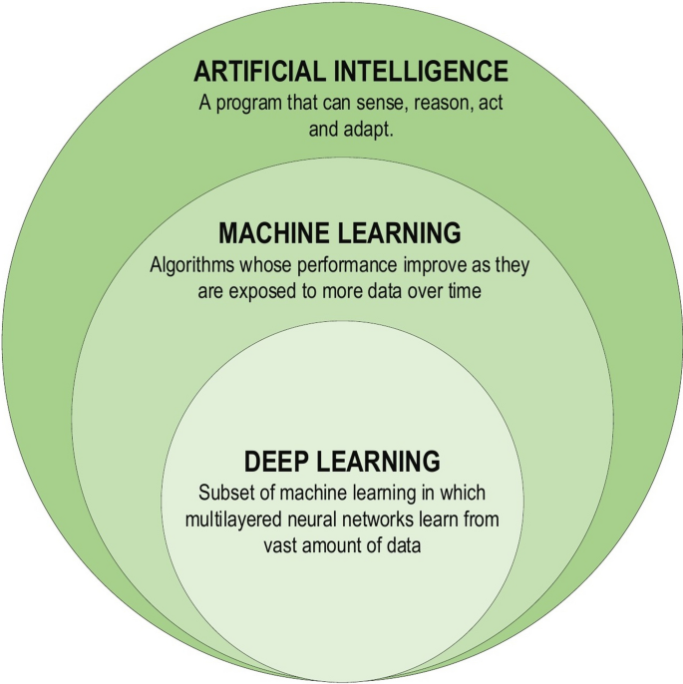
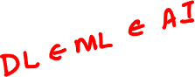
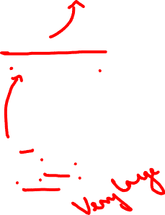
General ML Pipeline

Slide 5
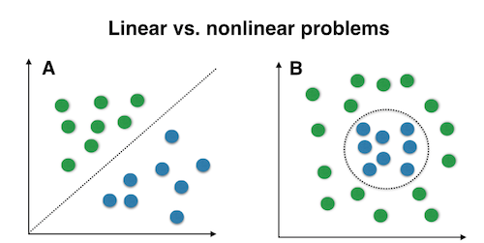
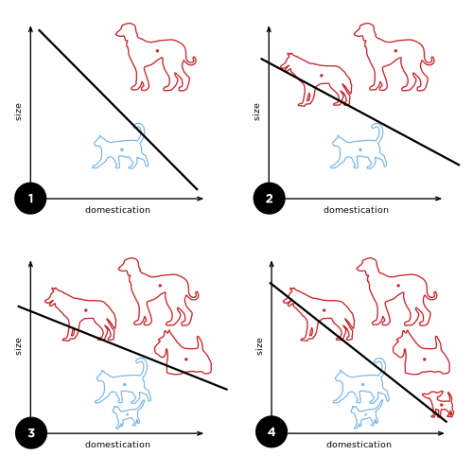
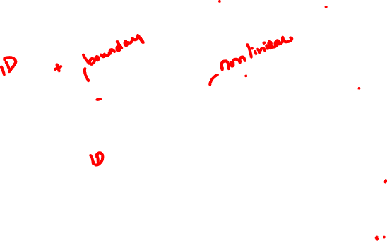
Machine Learning vs. Deep Learning: Decision Boundary
In the case of classification problems, the algorithm learns the function that separates 2 classes – this is known as a Decision boundary. A decision boundary helps us in determining whether a given data point belongs to a positive class or a negative class.
Every Machine Learning algorithm is not capable of learning all the functions. This limits the problems these algorithms can solve that involve a complex relationship.

Slide 6
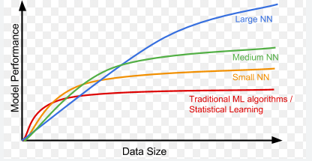
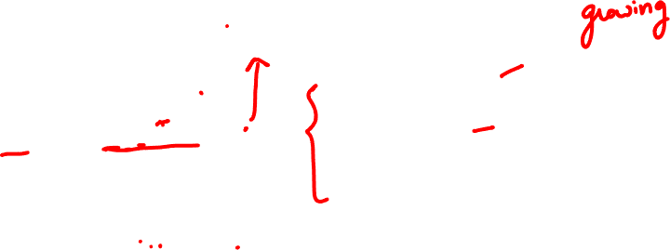
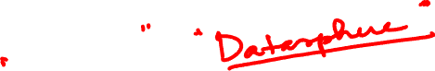
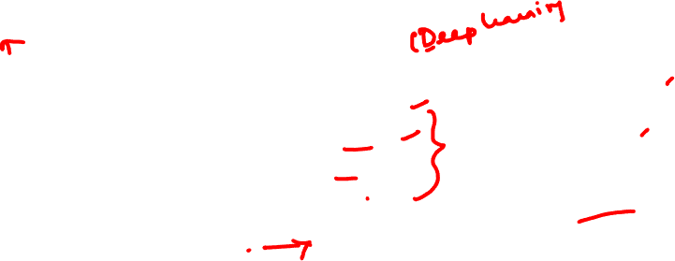
Why Deep Learning
When the amount of data is increased, machine learning algorithms techniques are insufficient in terms of
performance and deep learning gives better performance like accuracy
Why now?
Advanced Algorithms, APIs,Platfoms
GPU Computing
Availability of large training data( due to smart phones and devices) in millions

Slide 7
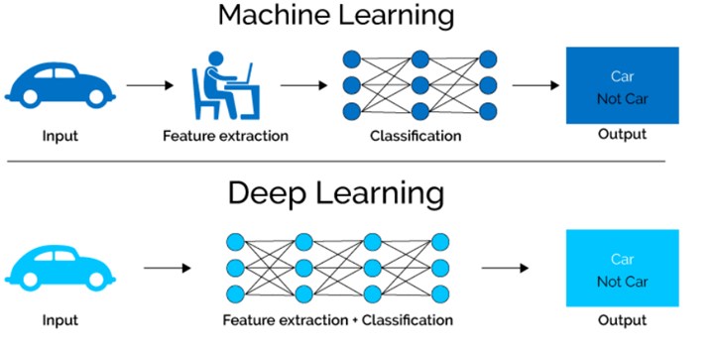
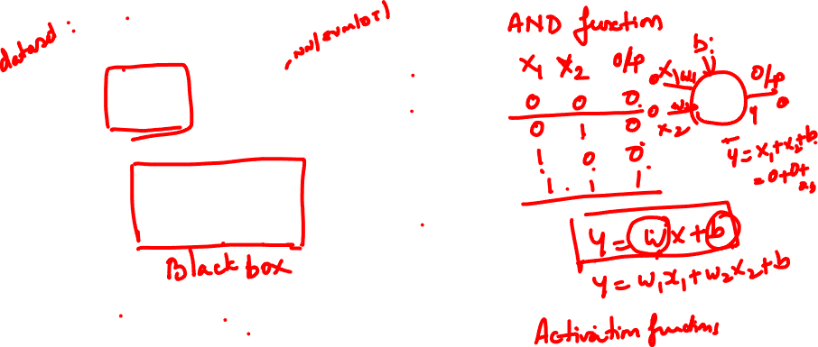
Deep Learning
Extracting features manually from an image needs strong knowledge of the subject as well as the domain. It is an extremely time-consuming process. Thanks to Deep Learning, we can automate the process of Feature Engineering!

Slide 8
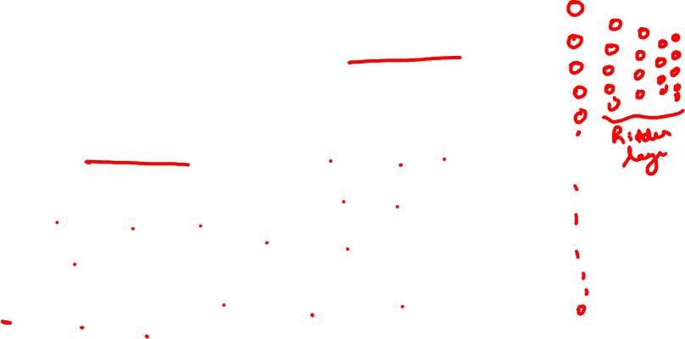
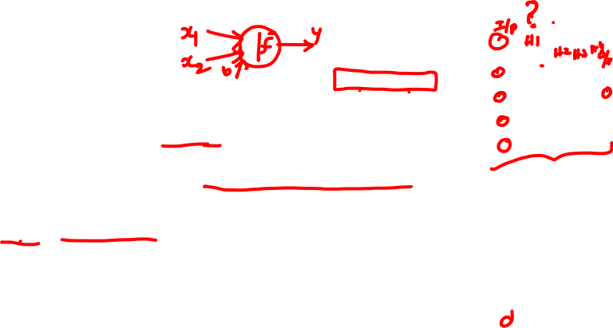
Deep Learning
Deep learning structures algorithms in layers to create an "artificial neural network” that can learn and make intelligent decisions on its own
In practical terms, deep learning is just a subset of machine learning. In fact, deep learning technically is machine learning and functions in a similar way (hence why the terms are sometimes loosely interchanged). However, its capabilities are different.
While basic machine learning models do become progressively better at whatever their function is, they still need some guidance.
If an AI algorithm returns an inaccurate prediction, then an engineer has to step in and make adjustments.
With a deep learning model, an algorithm can determine on its own if a prediction is accurate or not through its own neural network.

Slide 9
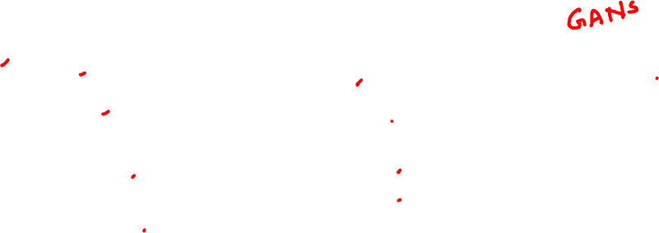
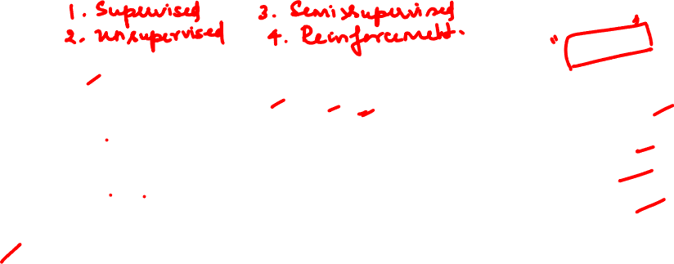
Deep Learning
Three main areas where Deep Learning is being prominently applied
1.Detection
Text & Speech
Image interpretation
2.Prediction
Recommendations
Individual behaviour & condition
3.Generation
Visual Art
Design
Human behaviour & Identity
Abuse & Fraud
Collective behaviour
Music
Text

Slide 10
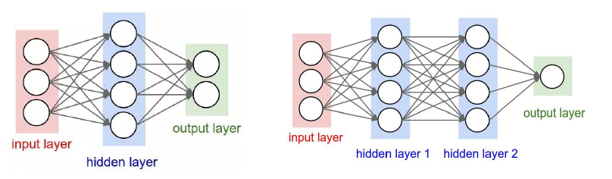
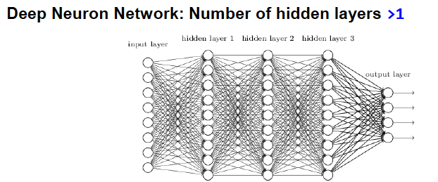
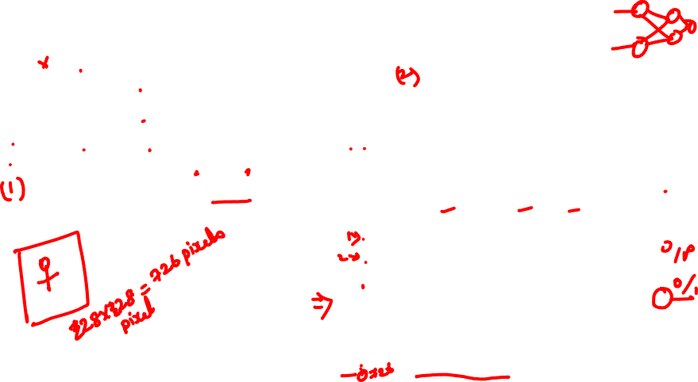
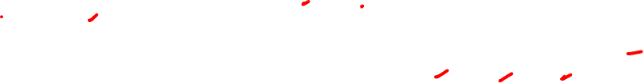
Deep Learning
Deep Learning is the branch of Machine Learning based on Deep Neural Networks (DNNs, i.e., neural networks composed of more than 1 hidden layer).

Slide 11
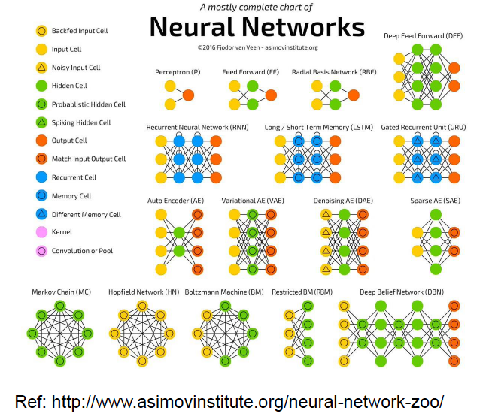
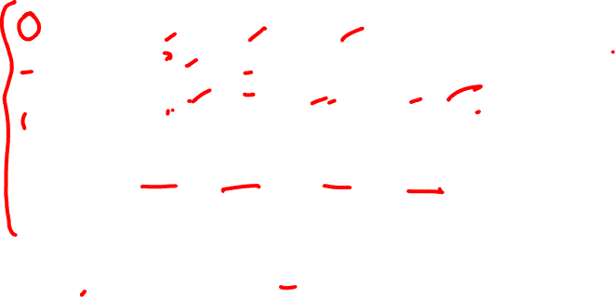
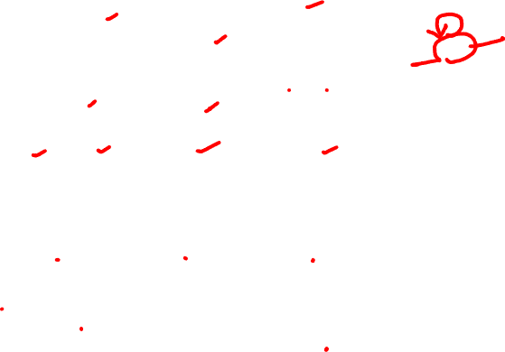
Deep Learning

Slide 12
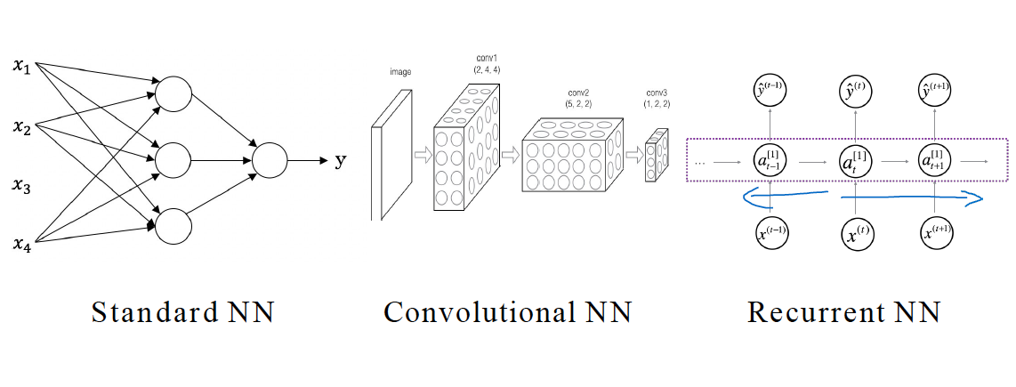
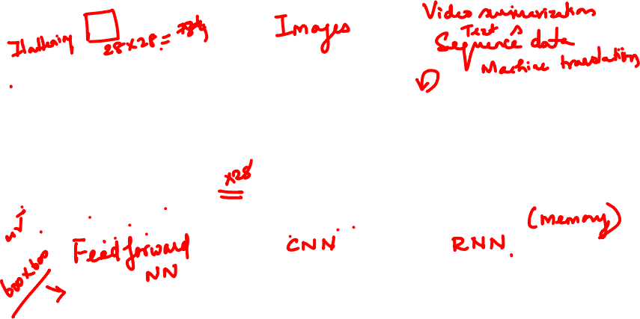
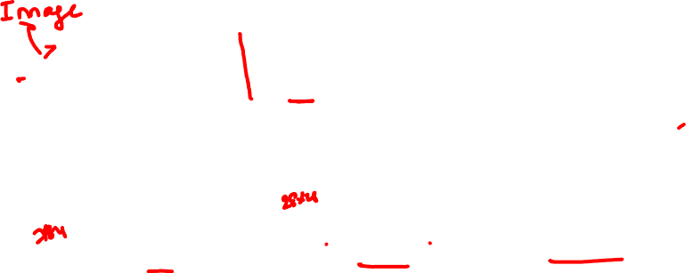
Deep Learning

Slide 13
Deep Learning
Feed forward Neural Network/ANN
The feed forward model is a basic type of neural network because the input is only processed in one direction. Feed forward neural networks are artificial neural networks in which nodes do not form loops. This type of neural network is also known as a multi-layer neural network as all information is only passed forward.
During data flow, input nodes receive data, which travel through hidden layers, and exit output nodes.
As a feed forward neural network model, the single-layer perceptron often gets used for classification. Machine learning can also get integrated into single-layer perceptrons. Through training, neural networks can adjust their weights based on a property called the delta rule, which helps them compare their outputs with the intended values.
As a result of training and learning, gradient descent occurs. Similarly, multi-layered perceptrons update their weights. But, this process gets known as back-propagation. If this is the case, the network's hidden layers will get adjusted according to the output values produced by the final layer. Backpropagation is a technique based on gradient descent

Slide 14
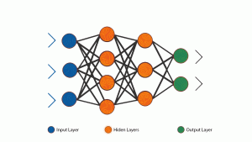
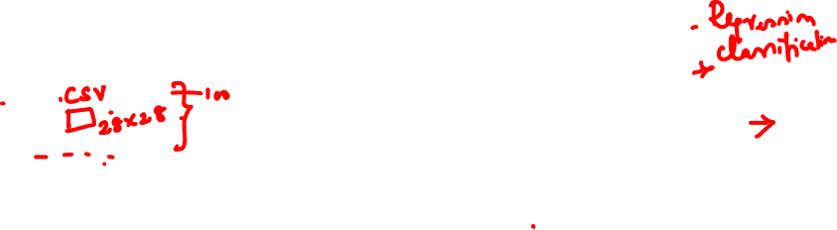
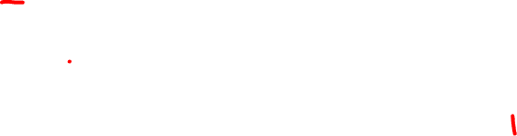
Deep Learning
Feed forward Neural Network/ANN
ANN can be used to solve problems related to:
Tabular data
Image data
Text data

Slide 15
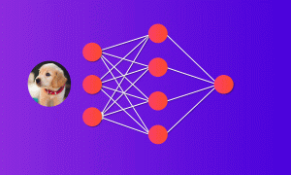
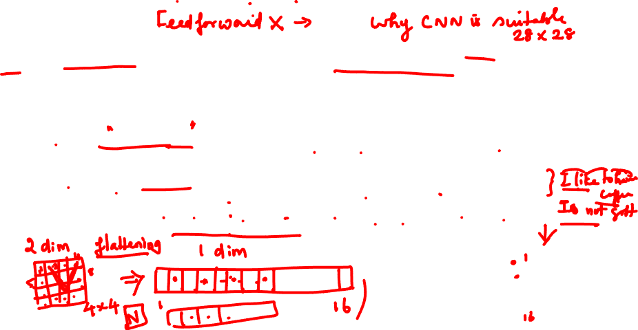
Challenges with Neural Network
While solving an image classification problem using ANN, the first step is to convert a 2-dimensional image into a 1-dimensional vector prior to training the model. This has two drawbacks:
The number of trainable parameters increases drastically with an increase in the size of the image. If the size of the image is 224*224, then the number of trainable parameters at the first hidden layer is 602,112. That’s huge!
ANN loses the spatial features of an image. Spatial features refer to the arrangement of the pixels in an image.
ANN cannot capture sequential information in the input data which is required for dealing with sequence data
to overcome the limitations of MLP using two different architectures – Recurrent Neural Networks (RNN) and Convolution Neural Networks (CNN).

Slide 16

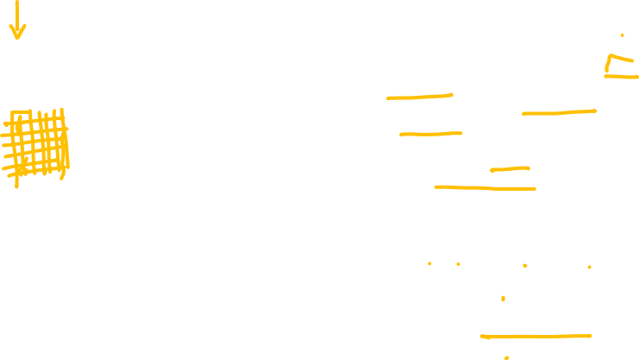
CNN
The building blocks of CNNs are filters a.k.a. kernels. Kernels are used to extract the relevant features from the input using the convolution operation.
CNN learns the filters automatically without mentioning it explicitly. These filters help in extracting the right and relevant features from the input data
CNN captures the spatial features from an image. Spatial features refer to the arrangement of pixels and the relationship between them in an image. They help us in identifying the object accurately, the location of an object, as well as its relation with other objects in an image
https://www.analyticsvidhya.com/blog/2020/02/cnn-vs-rnn-vs-mlp-analyzing-3-types-of-neural-networks-in-deep-learning/

Slide 17
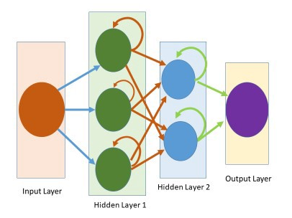
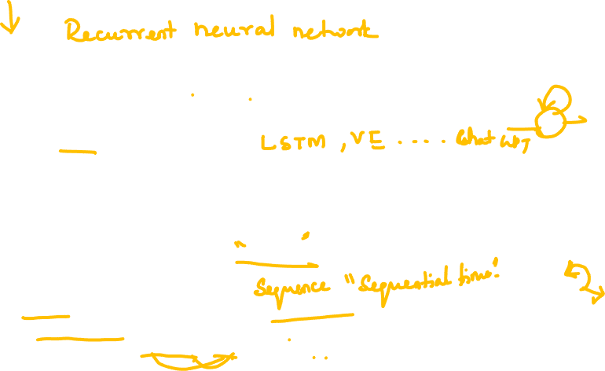
RNN
Artificial neural networks (ANN) are feedforward networks that take inputs and produce outputs, whereas RNNs learn from previous outputs to provide better results the following time.
Apple's Siri and Google's voice search algorithm are exemplary applications of RNNs in machine learning.
As the name implies, recurrent neural networks have a recurrent connection in which the output is transmitted back to the RNN neuron rather than only passing it to the next node.
Each node in the RNN model functions as a memory cell, continuing calculation and operation implementation.
An RNN remembers every piece of information throughout time. It is only effective in time series prediction because of the ability to recall past inputs. This is referred to as long short-term memory (LSTM)

Slide 18
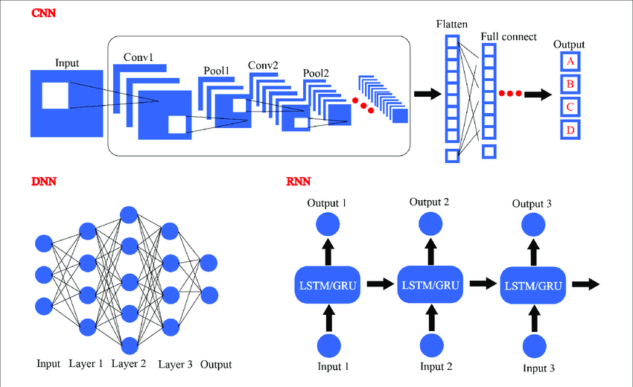

ANN Vs RNN Vs CNN
https://www.researchgate.net/figure/Several-different-frameworks-of-deep-learning-including-convolutional-neural-network_fig5_326470663

Slide 19
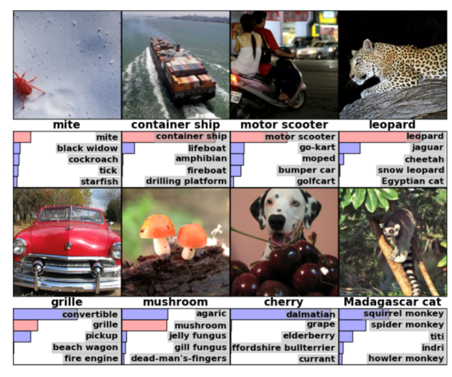
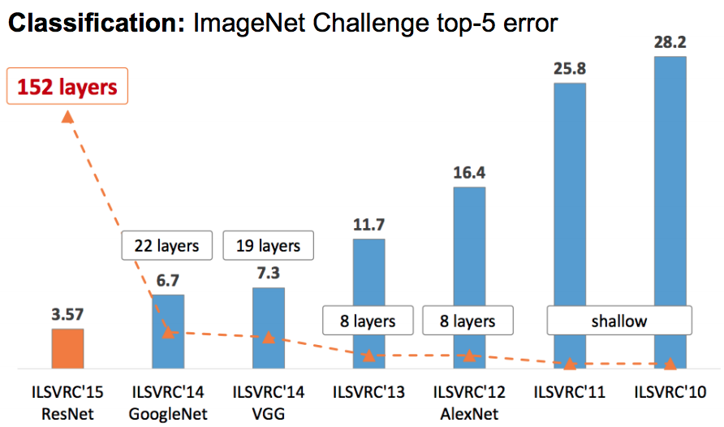
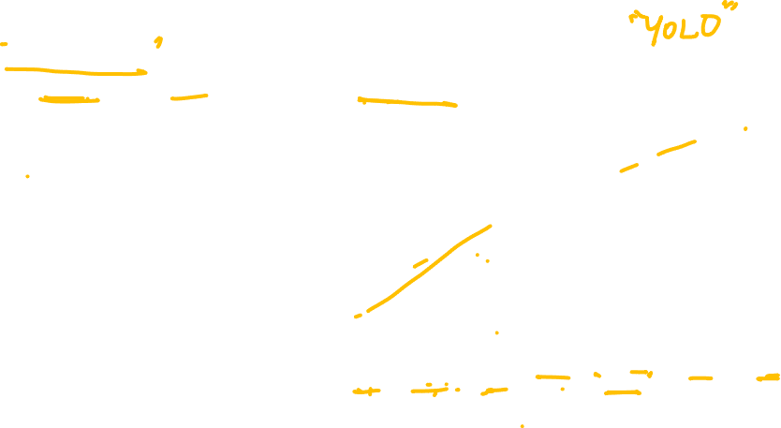
Deep Learning (DL)
Deep neural networks are capable of solving very complex problems
ImageNet Challenge (2011): identify objects in images
4 million images in 21841 categories [Challenge 1000 categories]

Slide 20
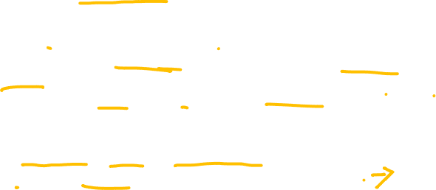
Key Points
DL is constructing network of parameterized functional modules and training them from examples using gradient based optimization – Yann Lecun
Traditional way to hand engineer feature is brittle and not scalable
Why now? because we have data (ImageNet …), compute power (GPUs) and software (tensorFlow)
DL learns underlying features/representations directly from data.
DL have been found useful to many real life problems. Capable of solving very complex problems.
As the data increases algorithm DL becomes better
Deep learning is NOT just adding more layers to a neural network.

Slide 21
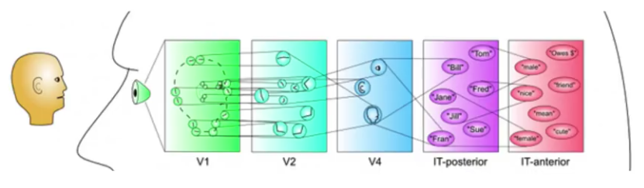
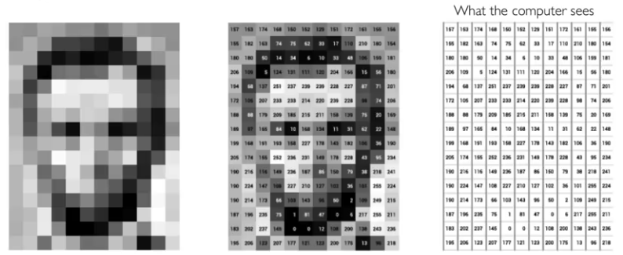
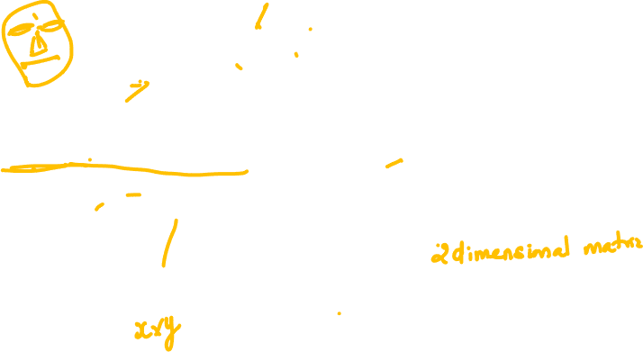
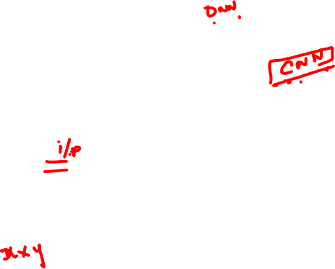
Visual Cortex is Hierarchical
DL helps to get hierarchy of features
Visual Cortex is Hierarchical
Images are numbers (so determine feature)
There could be occlusion, viewpoint variation, scale variation, illumination variation, deformation, background clutter, noise, intra-class variation and much more.

Slide 22
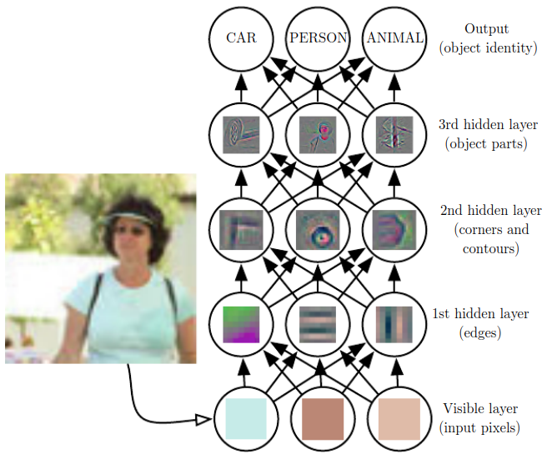
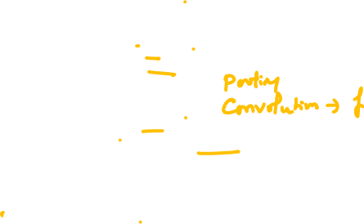
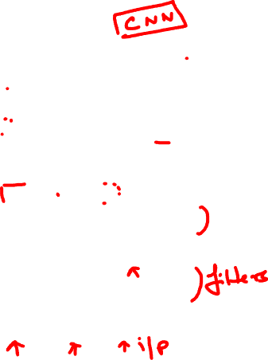
DL Builds Hierarchy of Features
Higher (or deeper) layers represents abstraction of the increasing complex features

Slide 23
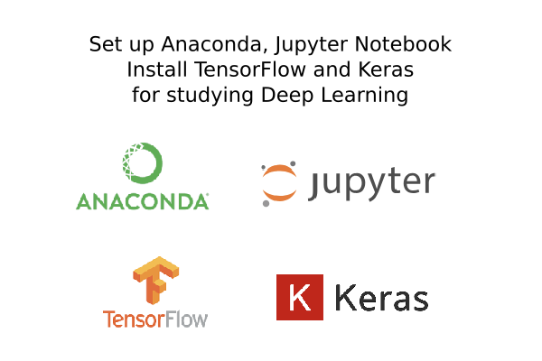
Deep Learning
Setup a Python Environment for Machine Learning and Deep Learning

Slide 24
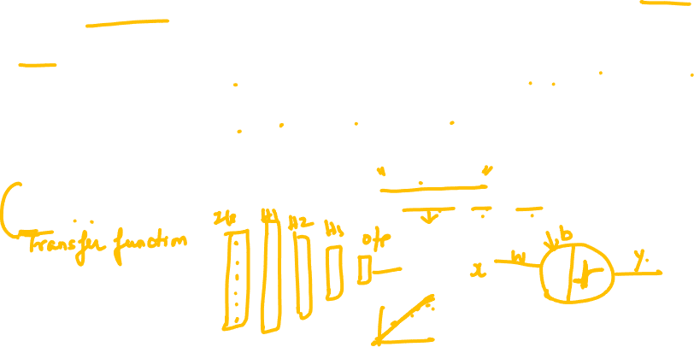

Key Components of Deep Learning
Deep learning is a subset of machine learning that deals with neural networks containing many layers, known as deep neural networks. The key components of deep learning include:
1. Neural Networks:
Neurons: Neurons are the fundamental units of a neural network. They receive inputs, apply weights, add biases, and pass the result through an activation function to produce an output.
Layers: Neural networks consist of layers of interconnected neurons. Common types of layers include input layers, hidden layers, and output layers. Deep neural networks have multiple hidden layers.
Weights and Biases: Neural networks learn by adjusting weights and biases associated with connections between neurons. These parameters are tuned during the training process to minimize the error.
Activation Functions: Activation functions introduce non-linearities to the network, allowing it to learn complex patterns. Common activation functions include sigmoid, tanh, ReLU (Rectified Linear Unit), and softmax.

Slide 25
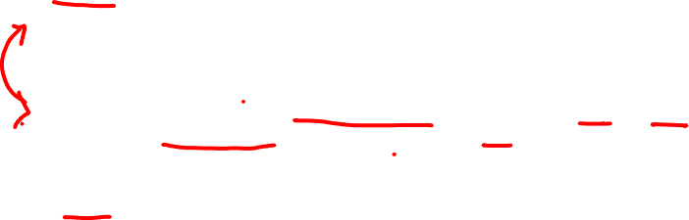
Key Components of Deep Learning
2. Loss Function:
A loss function (or objective function) measures the difference between the predicted outputs and the actual targets (labels). The goal during training is to minimize this loss, which represents the difference between predicted and actual values.
3. Optimization Algorithm:
Optimization algorithms, such as Gradient Descent and its variants (Adam, RMSprop, etc.), adjust the weights and biases iteratively to minimize the loss function. These algorithms determine how the neural network learns and converges towards optimal parameters.
4. Backpropagation:
Backpropagation is a technique used to calculate the gradients of the loss function with respect to the weights and biases in the network. It enables efficient optimization by propagating the errors backward through the network, allowing for weight updates that minimize the loss.

Slide 26

Key Components of Deep Learning
5. Layers and Architectures:
Convolutional Layers (CNNs): Convolutional layers apply convolution operations to input data, capturing spatial patterns. They are commonly used in image-related tasks.
Recurrent Layers (RNNs, LSTM, GRU): Recurrent layers maintain a hidden state and can capture sequential patterns. They are suitable for tasks involving sequences, such as natural language processing and time-series analysis.
Transformer Layers: Transformer architecture, based on self-attention mechanisms, is efficient for processing sequential data and is commonly used in natural language processing tasks.
Skip Connections: Skip connections (or residual connections) allow gradients to flow more directly during training, aiding in the training of very deep networks.
Pooling Layers: Pooling layers reduce the spatial dimensions of data, which is commonly used in CNNs to downsample feature maps.
Normalization Layers: Batch normalization and layer normalization are used to stabilize and accelerate the training process by normalizing the inputs to layers.

Slide 27
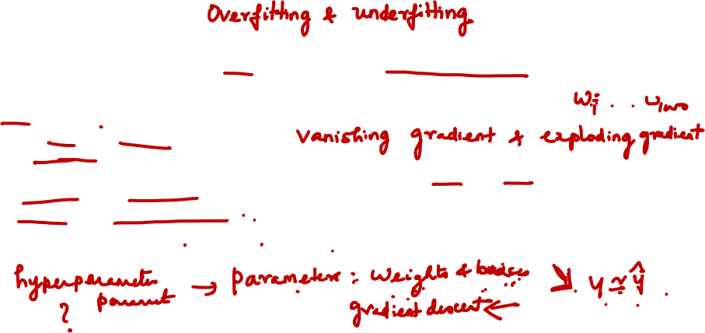

Key Components of Deep Learning
6. Regularization Techniques:
Techniques like Dropout (randomly setting some neurons' outputs to zero during training) and L1/L2 regularization help prevent overfitting, enhancing the model's generalization ability.
7. Initialization Strategies:
Proper initialization of weights is crucial for training deep networks. Techniques like Xavier/Glorot initialization ensure that weights are initialized in a way that prevents gradients from vanishing or exploding during training.
8. Hyperparameters:
Deep learning models have various hyperparameters, including learning rate, batch size, number of layers, number of neurons in each layer, and more. Tuning these hyperparameters is essential for achieving optimal performance.
Understanding and appropriately configuring these components are essential for building effective and accurate deep learning models tailored to specific tasks and datasets.

Slide 28
Hyperparameter tuning

Slide 29

Activation Functions
An Activation Function decides whether a neuron should be activated or not. This means that it will decide whether the neuron’s input to the network is important or not in the process of prediction using simpler mathematical operations.
The role of the Activation Function is to derive output from a set of input values fed to a node.
the purpose of an activation function is to add non-linearity to the neural network.
Without activation function, weight and bias would only have a linear transformation, or neural network is just a linear regression model, a linear equation is polynomial of one degree only which is simple to solve but limited in terms of ability to solve complex problems or higher degree polynomials.
But opposite to that, the addition of activation function to neural network executes the non-linear transformation to input and make it capable to solve complex problems such as language translations and image classifications.

Slide 30



Types of Activation Functions
A. Binary step function
B. Linear function
C. Non linear activation function
i)Sigmoid
ii) Softmax
iii) ReLU
iv) Leaky ReLU
v) tanh

Slide 31

Activation Functions
Typically the type of problems we consider under a machine learning environment falls either as classification or regression problem.
So we need to know
What should be the activation function for a regression problem?
What should be the activation function for classification problem?

Slide 32

Activation Functions
What is a loss function?
The function we want to minimize or maximize is called the objective function or criterion. When we are minimizing it, we may also call it the cost function, loss function, or error function.
It is a function that tells as a quantifiable value of how much error does our approximated model possess.
Typically, this involves the difference between the actual value and approximated(predicted) value.
Again based on the problem considered, the loss function also varies.

Slide 33

Types of loss function
Regression Loss Functions
Mean Squared Error Loss
Mean Squared Logarithmic Error Loss
Mean Absolute Error Loss
Binary Classification Loss Functions
Binary Cross-Entropy
Hinge Loss
Squared Hinge Loss
Multi-Class Classification Loss Functions
Multi-Class Cross-Entropy Loss
Sparse Multiclass Cross-Entropy Loss
Kullback Leibler Divergence Loss
Cross-entropy loss is often simply referred to as “cross-entropy,” “logarithmic loss,” “logistic loss,” or “log loss” for short.

Slide 34




Activation Functions
Regression: Predicting a numerical value(Preferred Activation F : Linear or RELU)
Loss Function
There are three metrics which are generally used for evaluation of Regression problems (like Linear Regression, Decision Tree Regression, Random Forest Regression etc.):
Mean Absolute Error (MAE): This measures the absolute average distance between the real data and the predicted data, but it fails to punish large errors in prediction.
Mean Square Error (MSE): This measures the squared average distance between the real data and the predicted data. Here, larger errors are well noted (better than MAE). But the disadvantage is that it also squares up the units of data as well. So, evaluation with different units is not at all justified.
Root Mean Squared Error (RMSE): This is actually the square root of MSE. Also, this metrics solves the problem of squaring the units.

Slide 35



Activation Functions
Categorical: Predicting a binary outcome (Preferred Activation F : Sigmoid)
Loss Function
Binary Cross Entropy — Cross entropy quantifies the difference between two probability distribution. Our model predicts a model distribution of {p, 1-p} as we have a binary distribution. We use binary cross-entropy to compare this with the true distribution {y, 1-y}
The final layer of the neural network will have one neuron and will return a value between 0 and 1, which can be inferred as a probably.

Slide 36



Activation Functions
Categorical: Predicting a single label from multiple classes (Preferred Activation F : Softmax)
Loss Function
Cross Entropy — Cross entropy quantifies the difference between two probability distribution. Our model predicts a model distribution of {p1, p2, p3} (where p1+p2+p3 = 1). We use cross-entropy to compare this with the true distribution {y1, y2, y3}
The final layer of the neural network will have one neuron for each of the classes and they will return a value between 0 and 1, which can be inferred as a probably. The output then results in a probability distribution as it sums to 1.

Slide 37


Activation Functions
Categorical: Predicting multiple labels from multiple classes (Preferred Activation F : Sigmoid)
Loss Function
E.g. predicting the presence of animals in an image
Binary Cross Entropy — Cross entropy quantifies the difference between two probability distribution. Our model predicts a model distribution of {p, 1-p} (binary distribution) for each of the classes. We use binary cross-entropy to compare these with the true distributions {y, 1-y} for each class and sum up their results
The final layer of the neural network will have one neuron for each of the classes and they will return a value between 0 and 1, which can be inferred as a probably.

Slide 38

Activation Functions
Which Loss Function to Use?
The choice of cost function is tightly coupled with the choice of output unit. Most of the time, we simply use the cross-entropy between the data distribution and the model distribution. The choice of how to represent the output then determines the form of the cross-entropy function.
1. Regression Problem
A problem where you predict a real-value quantity.
Output Layer Configuration: One node with a linear activation unit.
Loss Function: Mean Squared Error (MSE).
2. Binary Classification Problem
A problem where you classify an example as belonging to one of two classes.
The problem is framed as predicting the likelihood of an example belonging to class one, e.g. the class that you assign the integer value 1, whereas the other class is assigned the value 0.
Output Layer Configuration: One node with a sigmoid activation unit.
Loss Function: Cross-Entropy, also referred to as Logarithmic loss.

Slide 39
Activation Functions
Which Loss Function to Use?
3. Multi-Class Classification Problem
A problem where you classify an example as belonging to one of more than two classes.
The problem is framed as predicting the likelihood of an example belonging to each class.
Output Layer Configuration: One node for each class using the softmax activation function.
Loss Function: Cross-Entropy, also referred to as Logarithmic loss.

Slide 40


Activation Functions
Relationship between problems, loss and output activation function

Slide 41


Hyperparameter Tuning
There are many interesting questions for the network
How many layers?
How many units in each layer?
What should be the learning rate?
What is right activation function? etc.
Difficult to answer in the beginning
It is an iterative process
Demo
https://playground.tensorflow.org/

Slide 42

Hyperparameter tuning
Learning rate.
Momentum beta.
Mini-batch size.
No. of hidden units.
No. of layers.
Learning rate decay.
Regularization lambda.
Activation functions.
Adam beta1 & beta2.
Dropout rate
Mini batch size
Its hard to decide which hyperparameter is the most important in a problem. It depends a lot on your problem.
Try random values

Slide 43

Optimizers
Optimizers are algorithm that is used to tweak the parameters such that we reach the minimum of the loss function.
How should one change the weights and biases is defined by the optimizers we use.
Optimizers have been undergoing constant evolution, adding techniques that makes them perform faster and more efficiently

Slide 44

Optimizers
Different types of Optimizers used frequently:
Gradient Descent
Stochastic Gradient Descent
Mini-Batch Gradient Descent
SGD with Momentum
Adagrad
RMS-Prop
Adam (Adaptive Moment Estimation -RMS prop and momentum together)

Slide 45



Optimizers - Gradient Descent
Gradient Descent is something we have learnt before.
We find the gradient of the loss function with respect to the weights and biases
And move in small steps towards the opposite direction of the gradient (Gradient
points to ascent, we want direction of descent to reach the minimum)
Gradient Descent iteratively reduces a loss function by moving in the direction opposite to that of steepest ascent.

Slide 46

Optimizers
Optimizers - Gradient Descent
Advantages
Easy to implement
Good results most of the times
Disadvantages
Can get stuck in local minimas
Because this method calculates the gradient for the entire data set in one update, the calculation is very slow
It requires large memory and it is computationally expensive

Slide 47

Optimizers- Stochastic Gradient descent
Vanilla Gradient descent, find the gradient for the entire dataset, and the updates the parameters, this method is slow and hence the convergence is slow. Further this may not be suitable for huge datasets.
Stochastic GD is a variation of Vanilla Gradient descent were, the gradient is updated every data item, instead of after going through entire dataset.
As the model parameters are frequently updated parameters have high variance and fluctuations in loss functions at different intensities
SGD uses a higher number of iterations to reach the local minima. Due to an increase in the number of iterations, the overall computation time increases. But even after increasing the number of iterations, the computation cost is still less than that of the vanilla gradient descent optimizer.
If the data is enormous and computational time is an essential factor, stochastic gradient descent should be preferred over batch gradient descent algorithm

Slide 48


Optimizers- Stochastic Gradient Descent
Advantages
Frequent Updation of parameters
Less computationally expensive than Vanilla Gradient Descent
Allows the use of large data sets as it has to update only one example at a time
Uses less memory
Disadvantages
The frequent can also result in noisy gradients which may cause the error to increase instead of decreasing it.
High Variance.
Frequent
computationally expensive
Still prone to local minima

Slide 49
Optimizers- Mini Batch Gradient Descent
Mini Batch Gradient Descent combines the ideas of Vanilla GD and Stochastic GD.
We shuffle the data, and choose a mini batch of K items, we then calculate gradients for
this mini batch, and update the gradients.
This avoids the problem of computing gradients for the entire dataset and also the problem of frequent updation which causes noisy gradients. By finding a middle ground it is faster than both the variants.
As the algorithm uses batching, all the training data need not be loaded in the memory, thus making the process more efficient to implement
Moreover, the cost function in mini-batch gradient descent is noisier than the batch gradient descent algorithm but smoother than that of the stochastic gradient descent algorithm.
Because of this, mini-batch gradient descent is ideal and provides a good balance between speed and accuracy.

Slide 50

Optimizers- Summary
(mini batch size = m) ==> Batch gradient descent
(mini batch size = 1) ==> Stochastic gradient descent (SGD)
(mini batch size = between 1 and m) ==> Mini-batch gradient descent
Mini-batch size is a hyperparameter

Slide 51


Optimizers- Mini Batch Gradient Descent
Advantages:
Faster and more efficient than previous variants of GD
More efficient gradient calculation
Requires less amount of memory (Loads only one batch per updation)
Disadvantages:
Still prone to local minima
It introduces another hyperparameter K (the batch size)

Slide 52

Hyperparameters
We need to tune our hyperparameters to get the best out of them.
Hyperparameters importance are (as for Andrew Ng):
Learning rate.
Momentum beta.
Mini-batch size.
No. of hidden units.
No. of layers.
Learning rate decay.
Regularization lambda.
Activation functions.
Adam beta1 & beta2.
Its hard to decide which hyperparameter is the most important in a problem. It depends a lot on your problem.
One of the ways to tune is to sample a grid with N hyperparameter settings and then try all settings combinations on your problem.
Try random values: don't use a grid.

Slide 53


Optimizers
Summary :
It helps to accelerate gradient vectors in the right directions, that helps in faster convergence.
It will moderate the movements in vertical directions and helps to move faster in the horizontal direction
Instead of calculating gradients independently we use exponentially weighted averages to calculate gradient.

Slide 54
Hyperparameter tuning

Slide 55
Hyperparameter tuning

Slide 56
Hyperparameter tuning

Slide 57



Error Surface
Backpropagation over multilayer networks is only guaranteed to converge toward some local minimum and not necessarily to the global minimum error
In deeper networks, often local minima is close to global minima
But, number of saddle point grows exponentially with depth of the network
Stochastic gradient descent owing to noise in gradient calculation is efficient in escaping saddle point during training of deep networks

Slide 58
DEEP LEARNING AND ANN Regularization
Dr. Bharathi R
CSE Department

Slide 59

Regularization
Underfitting Vs. Overfitting
L2 regularization
Dropout
Data Augmentation
Early Stopping

Slide 60

Which side do you want to be?
Train:Validation:Test split 60:20:20 or 99:1:1
High
(3rd choice)
I don’t want
to be here!
Testing Error
Risk of overfitting
This is even better
(1st choice)
This is better
(2nd choice)
Low
High
Training Error
Low training error comes with a risk of overfitting (high variance)

Slide 61


Bias and Variance Trade Off
There is inverse relationship between bias and variance in machine learning.
Increasing the bias will decrease the variance.
Increasing the variance will decrease the bias.
If our model is too simple and has very few parameters then it may have high bias and low variance. On the other hand if our model has large number of parameters then it’s going to have high variance and low bias.
We need to find the right/good balance without overfitting and underfitting the data.
This tradeoff in complexity is why there is a tradeoff between bias and variance. An algorithm can’t be more complex and less complex at the same time.

Slide 62

To reduce High Variance
1 | Add more training data | Simplest and most reliable way to address variance, so long as you have access to significantly more data and enough computational power to process the data
2 | Add regularization(L2, L1 regularization, dropout, data augumentation) | This reduces variance, but increases bias
3 | Add early stopping( stop gradient descent early based on dev set error) | reduces variance, but increases bias
4 | Modify model architecture | This can affect both bias and variance

Slide 63



Regularization for NN
Why Regularization?
One of the major aspects of training your machine learning model is avoiding overfitting. The model will have a low accuracy if it is overfitting.
This happens because your model is trying too hard to capture the noise in your training dataset. By noise we mean the data points that don’t really represent the true properties of your data, but random chance. Learning such data points, makes your model more flexible, at the risk of overfitting.
The concept of balancing bias and variance, is helpful in understanding the phenomenon of overfitting.

Slide 64

Regularization for NN
Types of Regularization
L2 and L1 regularization
Dropout
Data Augmentation
Early stopping

Slide 65

Regularization for NN
L2 and L1 regularization
What’s L1 and L2?
L1 and L2 regularisation owes its name to L1 and L2 norm of a vector w respectively. Here’s a primer on norms:
1-norm (also known as L1 norm)
2-norm (also known as L2 norm or Euclidean norm)

Slide 66




Regularization for NN
L1 and L2 Regularization
A linear regression model that implements L1 norm for regularisation is called lasso regression, and one that implements (squared) L2 norm for regularisation is called ridge regression.
To implement these two, note that the linear regression model stays the same:
Loss function with no regularisation
Loss function with L1 regularisation
Loss function with L2 regularisation

Slide 67

Regularization for NN
The normal cost function that we want to minimize is: J(w,b) = (1/m) * Sum(L(y(i),y'(i)))
The L2 regularization version: J(w,b) = (1/m) * Sum(L(y(i),y'(i))) + (lambda/2m) * Sum(|w[i]|^2)
The L1 regularization version: J(w,b) = (1/m) * Sum(L(y(i),y'(i))) + (lambda/2m) * Sum(|w[i]|)
The L1 regularization version makes a lot of w values become zeros, which makes the model size smaller.
L2 regularization is being used much more often.
lambda here is the regularization parameter (hyperparameter)

Slide 68





L1 - Loss function with L1 regularisation
Based on the above loss function, adding an L1 regularisation term to it looks like this:
where the regularisation parameter λ > 0 is manually tuned. Let’s call this loss function L1. Note that |w| is differentiable everywhere except when w=0, as shown below. We will need this later.
Similarly, adding an L2 regularisation term to L looks like this:
where again, λ > 0.

Slide 69


Regularization for NN
Use Gradient Descent to update weight
Now, let’s solve the linear regression model using gradient descent optimization based on the 3 loss functions defined above.
Recall that updating the parameter w in gradient descent is as follows:
where L is Loss function

Slide 70




Use Gradient Descent to update weight
Let’s substitute the last term in the above equation with the gradient of L, L1 and L2 w.r.t. w.
L2:
L :
L1 :

Slide 71

Regularization for NN
What does a Regularization achieve?
A standard least squares model tends to have some variance in it, i.e. this model won’t generalize well for a data set different than its training data.
Regularization, significantly reduces the variance of the model, without substantial increase in its bias.
So the tuning parameter λ, used in the regularization techniques, controls the impact
on bias and variance.
As the value of λ rises, it reduces the value of coefficients and thus reducing the variance. Till a point, this increase in λ is beneficial as it is only reducing the variance(hence avoiding overfitting), without loosing any important properties in the data.
But after certain value, the model starts loosing important properties, giving rise to bias in the model and thus underfitting. Therefore, the value of λ should be carefully selected.
Reference: https://towardsdatascience.com/regularization-in-machine-learning-76441ddcf99a

Slide 72
What does a Regularization achieve?
A standard least squares model tends to have some variance in it, i.e. this model won’t generalize well for a data set different than its training data.
Regularization, significantly reduces the variance of the model, without substantial increase in its bias.
So the tuning parameter λ, used in the regularization techniques, controls the impact
on bias and variance.
As the value of λ rises, it reduces the value of coefficients and thus reducing the variance. Till a point, this increase in λ is beneficial as it is only reducing the variance(hence avoiding overfitting), without loosing any important properties in the data.
But after certain value, the model starts loosing important properties, giving rise to bias in the model and thus underfitting. Therefore, the value of λ should be carefully selected.
Reference: https://towardsdatascience.com/regularization-in-machine-learning-76441ddcf99a

Slide 73

Regularization for NN
Solved Numerical
Vector L1 Norm
||v||1 = |a1| + |a2| + |a3|
# L1 norm of a vector
from numpy import array
from numpy.linalg import norm
a = array([1, 2, 3])
print(a)
L1 = norm(a, 1)
print(L1)
Answer: 1+2+3 =6
Vector L2 Norm
||v||2 = sqrt(a1^2 + a2^2 + a3^2)
# l2 norm of a vector
from numpy import array
from numpy.linalg import norm
a = array([1, 2, 3])
print(a)
l2 = norm(a)
print(l2)
Answer : 3.74

Slide 74



Regularization for NN
Dropout:
This is the one of the most interesting types of regularization techniques. It also produces very good results and is consequently the most frequently used regularization technique in the field of deep learning.
To understand dropout, let’s say our neural network structure is akin to the one shown below
So what does dropout do? At every iteration, it randomly selects some nodes and removes them along with all of their incoming and outgoing connections as shown in right figure

Slide 75


Regularization for NN
What is Dropout?
Dropout means leaving some units
Temporarily remove a node and both its incoming and
outgoing connections.
This thins the neural network
Note: Given a total of “n” nodes what are the total number of thinned networks that can be formed? 2^n

Slide 76


Regularization for NN
Train several neural
networks
having
different architectures
Train multiple instances of the same network using different training samples.
“ Expensive options”
Both at training as well as at testing levels
Hence solution is dropout

Slide 77


Regularization for NN
Dropout Training
Share the weights across all the networks
Sample a different network for each training instance
Steps:
Initialize the weights and start training
For first mini batch apply dropout resulting in a thinned network
Compute loss and backpropagate
Only active parameters gets updated

Slide 78



Dropout
Input
Input
Input
Output
Output
Output
X₁
Y₁
X₂
Y₂
X₃
Y₃
The pattern of dropped nodes changes for each input, i.e., in every pass through the net
•

Slide 79



Dropout
Input
Input
Input
Output
Output
Output
X₁
Y₁
X₂
Y₂
X₃
Y₃
During training: Backpropagation is effectively performed only over the remaining network
The effective network is different for different inputs
Gradients are obtained only for the weights and biases from “On” nodes to “On” nodes
For the remaining, the gradient is just 0

Slide 80



Regularization
Dropout
Visualizing the Loss Landscape of Neural Nets, Hao Li, Zheng Xu, Gavin Taylor, Christoph Studer, Tom Goldstein, 2018
Early stopping

Slide 81


Other Regularization Methods
Increase the data by data augmentation
Flip, rotate, scale, translate, deform ....
Normalize training examples to speed up your training

Slide 82


Other Regularization Methods: Data Augumentation
Introducing new synthetic images
If we are dealing with images, there are a few ways of increasing the size of the training data – rotating the image, flipping, scaling, shifting, etc.
Another solution is the sourcing of entirely new, synthetic images through various techniques, for example the use of generative adversarial networks to create new synthetic images for data augmentation.
Additionally, image recognition algorithms show improvement when transferring from images rendered in virtual environments to real-world data.
Data augmentation usually provides a big leap in improving the accuracy of the model. It can be considered as a mandatory trick in order to improve our predictions. It is usually a effective and quick solution to overfitting.

Slide 83


Other Regularization Methods: Data Augumentation
Why is there a need for a large amount of data?

Slide 84
Thank you

